Slide 1
Intrusion detection Information Security
William stalling
Chapter 8
Dr. Tehsin Kanwal

Slide 2
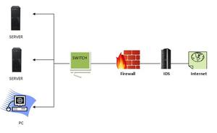
Intrusion Detection
A security service that monitors and analyzes system events for the purpose of finding, and providing real-time or near real-time warning of, attempts to access system resources in an unauthorized manner.
A system called an intrusion detection system (IDS) observes network traffic for malicious transactions and sends immediate alerts when it is observed.
It is software that checks a network or system for malicious activities or policy violations.

Slide 3
How does an IDS work?
An IDS (Intrusion Detection System) monitors the traffic on a computer network to detect any suspicious activity.
It analyzes the data flowing through the network to look for patterns and signs of abnormal behavior.
The IDS compares the network activity to a set of predefined rules and patterns to identify any activity that might indicate an attack or intrusion.
If the IDS detects something that matches one of these rules or patterns, it sends an alert to the system administrator.
The system administrator can then investigate the alert and take action to prevent any damage or further intrusion.

Slide 4
An IDS comprises three logical components
Sensors: Sensors are responsible for collecting data. The input for a sensor may be any part of a system that could contain evidence of an intrusion.
Types of input to a sensor includes network packets, log files, and system call traces. Sensors collect and forward this information to the analyzer.
Analyzers: Analyzers receive input from one or more sensors or from other analyzers.
The analyzer is responsible for determining if an intrusion has occurred. The output of this component is an indication that an intrusion has occurred. The output may include evidence supporting the conclusion that an intrusion occurred.
The analyzer may provide guidance about what actions to take as a result of the intrusion. The sensor inputs may also be stored for future analysis and review in a storage or database component.
User interface: The user interface to an IDS enables a user to view output from the system or control the behavior of the system. In some systems, the user interface may equate to a manager, director, or console component

Slide 5
IDSs: Types-Classification
Host-based IDS (HIDS)
Network-based IDS (NIDS)
Distributed or hybrid IDS

Slide 6
Host-based IDS (HIDS):
Host-based IDS (HIDS): Monitors the characteristics of a single host and the events occurring within that host, such as process identifiers and the system calls they make, for evidence of suspicious activity.
A HIDS monitors the incoming and outgoing packets from the device only and will alert the administrator if suspicious or malicious activity is detected.

Slide 7
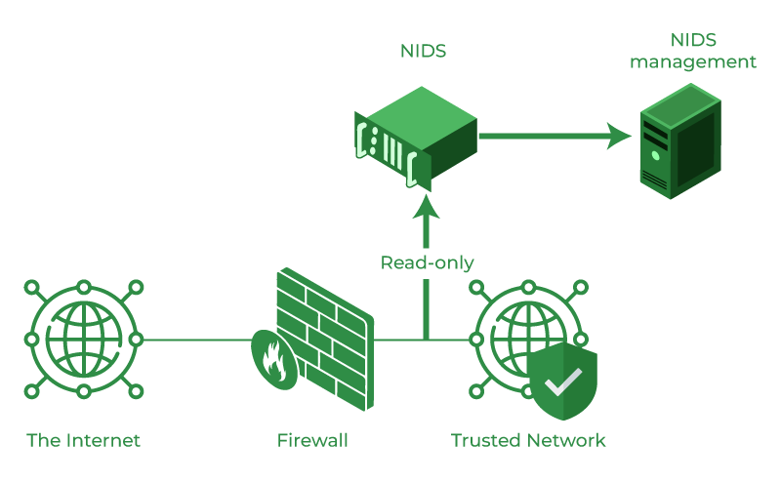
IDSs: Classification
Network-based IDS (NIDS): Monitors network traffic for particular network segments or devices and analyzes network, transport, and application protocols to identify suspicious activity.

Slide 8
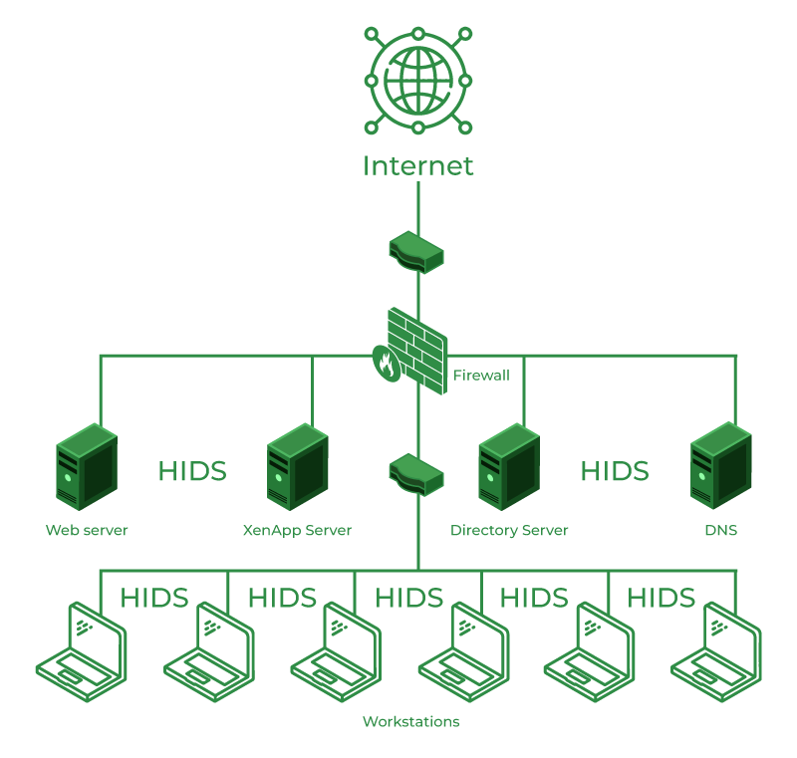
Distributed or hybrid IDS
Distributed or hybrid IDS: Combines information from a number of sensors, often both host and network-based, in a central analyzer that is able to better identify and respond
Hybrid intrusion detection system is made by the combination of two or more approaches to the intrusion detection system.
The hybrid intrusion detection system is more effective in comparison to the other intrusion detection system. Prelude is an example of Hybrid IDS.

Slide 9
Detection Methods of IDS OR Analysis Approaches
IDSs typically use one of the following alternative approaches to analyze sensor data to detect intrusions:
1. Anomaly detection: Involves the collection of data relating to the behavior of legitimate users over a period of time. Then current observed behavior is analyzed to determine with a high level of confidence whether this behavior is that of a legitimate user or alternatively that of an intruder.
2. Signature or Heuristic detection: Uses a set of known malicious data patterns (signatures) or attack rules (heuristics) that are compared with current behavior to decide if is that of an intruder.
It is also known as misuse detection. This approach can only identify known attacks for which it has patterns or rules.

Slide 10
Signature-based Method:
Signature-based Method: Signature-based IDS detects the attacks on the basis of the specific patterns such as the number of bytes or a number of 1s or the number of 0s in the network traffic.
It also detects on the basis of the already known malicious instruction sequence that is used by the malware.
The detected patterns in the IDS are known as signatures. Signature-based IDS can easily detect the attacks whose pattern (signature) already exists in the system but it is quite difficult to detect new malware attacks as their pattern (signature) is not known.

Slide 11
Anomaly Detection
The anomaly detection approach involves first developing a model of legitimate user behavior by collecting and processing sensor data from the normal operation of the monitored system in a training phase.

Slide 12
Anomaly-based Method:
Anomaly-based IDS was introduced to detect unknown malware attacks as new malware is developed rapidly.
In anomaly-based IDS there is the use of machine learning to create a trustful activity model and anything coming is compared with that model and it is declared suspicious if it is not found in the model.
The machine learning-based method has a better-generalized property in comparison to signature-based IDS as these models can be trained according to the applications and hardware configurations.

Slide 13
Anomaly Detection: Classification Approaches
Statistical: Analysis of the observed behavior using univariate, multivariate, or time-series models of observed metrics.
Knowledge based: Approaches use an expert system that classifies observed behavior according to a set of rules that model legitimate behavior. • Machine-learning: Approaches automatically determine a suitable classification model from the training data using data mining techniques
Machine-learning: Approaches automatically determine a suitable classification model from the training data using data mining

Slide 14
Attacks identified using Anomaly Detection Techniques
Denial-of-service (DoS) attacks: Such attacks involve either significantly increased packet traffic or significantly increase connection attempts, in an attempt to overwhelm the target system.
Scanning: A scanning attack occurs when an attacker probes a target network or system by sending different kinds of packets. Using the responses received from the target, the attacker can learn many of the system’s characteristics and vulnerabilities.
Scanning can be detected by atypical flow patterns at the application layer (e.g., banner grabbing3 ), transport layer (e.g., TCP and UDP port scanning), and network layer (e.g., ICMP scanning).
Worms: Worms spreading among hosts can be detected in more than one way. Some worms propagate quickly and use large amounts of bandwidth. Worms can also be detected because they can cause hosts to communicate with each other that typically do not, and they can also cause hosts to use ports that they normally do not use.

Slide 15
Benefits of IDS
Detects malicious activity: IDS can detect any suspicious activities and alert the system administrator before any significant damage is done.
Improves network performance: IDS can identify any performance issues on the network, which can be addressed to improve network performance.
Compliance requirements: IDS can help in meeting compliance requirements by monitoring network activity and generating reports.
Provides insights: IDS generates valuable insights into network traffic, which can be used to identify any weaknesses and improve network security.

Slide 16
Conclusion
Intrusion Detection System (IDS) is a powerful tool that can help businesses in detecting and prevent unauthorized access to their network.
By analyzing network traffic patterns, IDS can identify any suspicious activities and alert the system administrator.
IDS can be a valuable addition to any organization’s security infrastructure, providing insights and improving network performance.
Reading Assignment : Honey pots
Additional reference Available At: https://www.geeksforgeeks.org/intrusion-detection-system-ids/

